Slide 1
Project C:
AI vs. Human Writing Comparison
Michelle Steinberger, Allison Krueger, Aidan Belmont, Jill Derodel
December 5th, 2025

Slide 2
Motivation
We chose to study the difference between AI writing and human writing. With AI being integrated in almost every aspect of our lives, it is no surprised that there is now AI writing. This brings up the question on if AI writing significantly differs from human writing.
This topic is very interesting to us as AI is being integrated with education which we are all encountering daily. By fitting a logistic regression model, we are able to compare AI writing to human writing and see if it is similar or different based on several different factors.

Slide 3
Data Description
The data was found using an online website that took a random samples of 250 AI written text as well as 250 human written texts. There is a total of 500 observations. The variables used to compare the works are structure, sentiment, style, and linguistic complexity. Thes variables can be found in both the AI texts and the human written texts and will be the basis for the logarithmic evaluation.
Here is the link to where we got the data for this project:
Rajak, P. (2025, December 1). Ai Vs Human Comparison Dataset. Kaggle. https://www.kaggle.com/datasets/prince7489/ai-vs-human-comparison-dataset?resource=download

Slide 4
Data Exploration
First, we made a new data set that makes a 0/1 binary variable. A human data point is counted as 1, and AI is counted as 0. This made it so that all the data is numeric instead of a mix of categorical and numeric
In the sgscatter output, we can see several promising predictors. Two of the ones that appear to have a slightly "s" shaped plot are plagiarism score and length chars. Additionally, quality score has a slightly negative looking relationship.
The most promising looking variable appears to be plagiarism score, so we went forward with that for the single variable analysis.

Slide 5

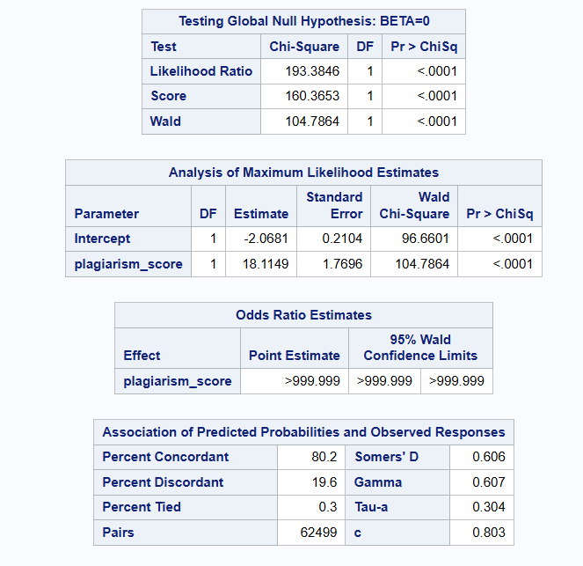
Model Fitting and Analysis
The parameter estimate for plagiarism score is 18.1149, and intercept is –2.0681.
The model appears to be highly significant, with P values well under 0.05, both <.0001
With a very significant likelihood ratio of <.0001 probability, we can safely say that our model including the predictor is better than the model without any predictors.

Slide 6
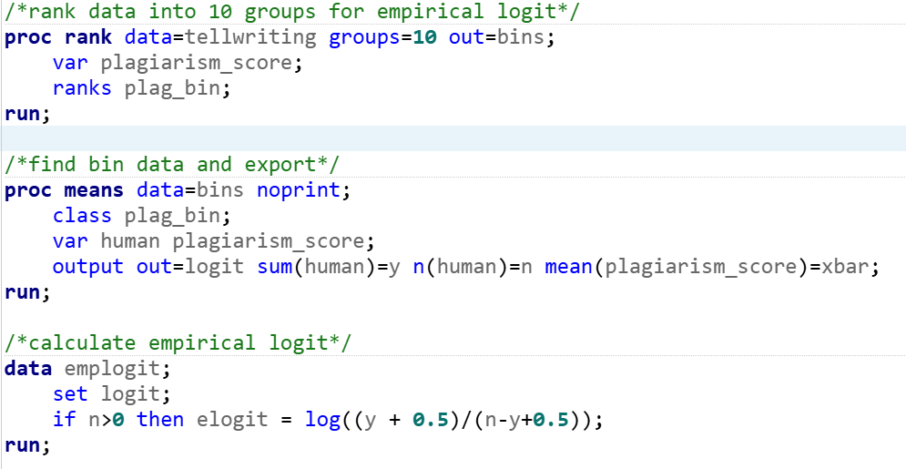
Model Fitting and Analysis
Logistic Regression Model
We ran the calculations to find the empirical logit by ranking the data into 10 bins. After exporting bin data and calculating empirical logit using the formula, we plotted it using proc sgscatter.
The line having a completely linear appearance proves that standard logistic regression is an appropriate approach to the model.

Slide 7
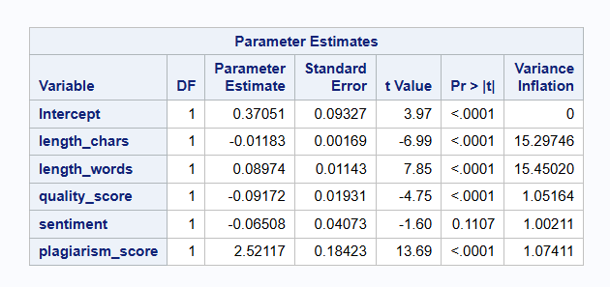
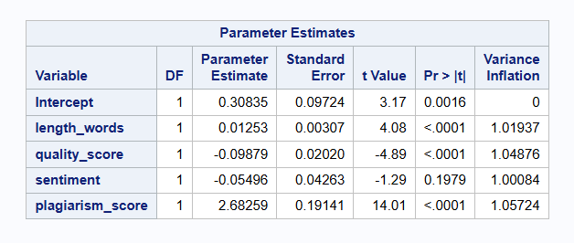
Model Fitting and Analysis - Multivariate
Multicollinearity
To determine multicollinearity, we ran the VIF statement on all of the predictors in the model.
Since length chars and length words have such high VIF values, we decided to remove one of them despite them both being significant, which fixed the issues.

Slide 8
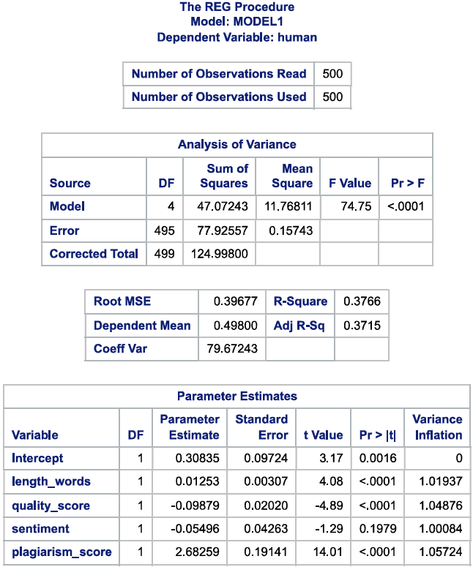
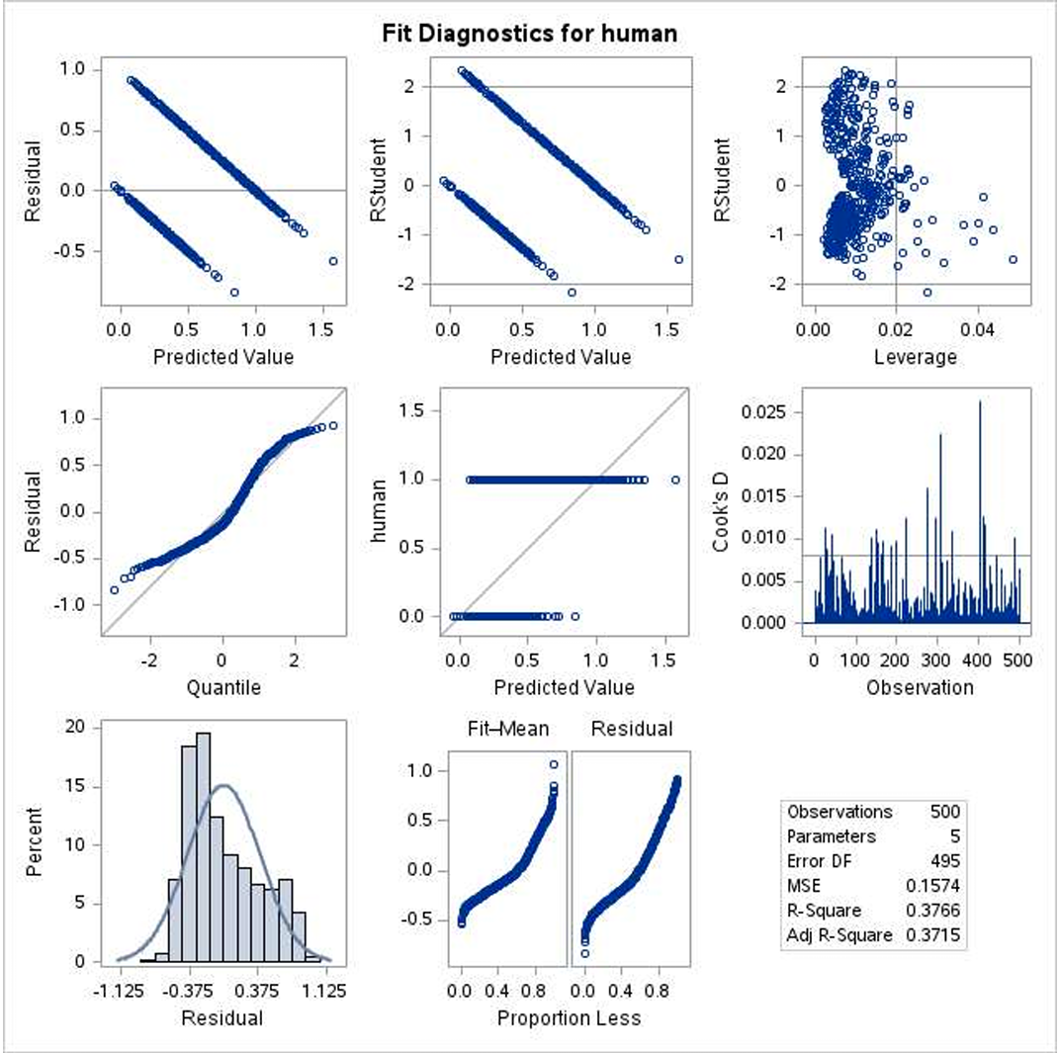
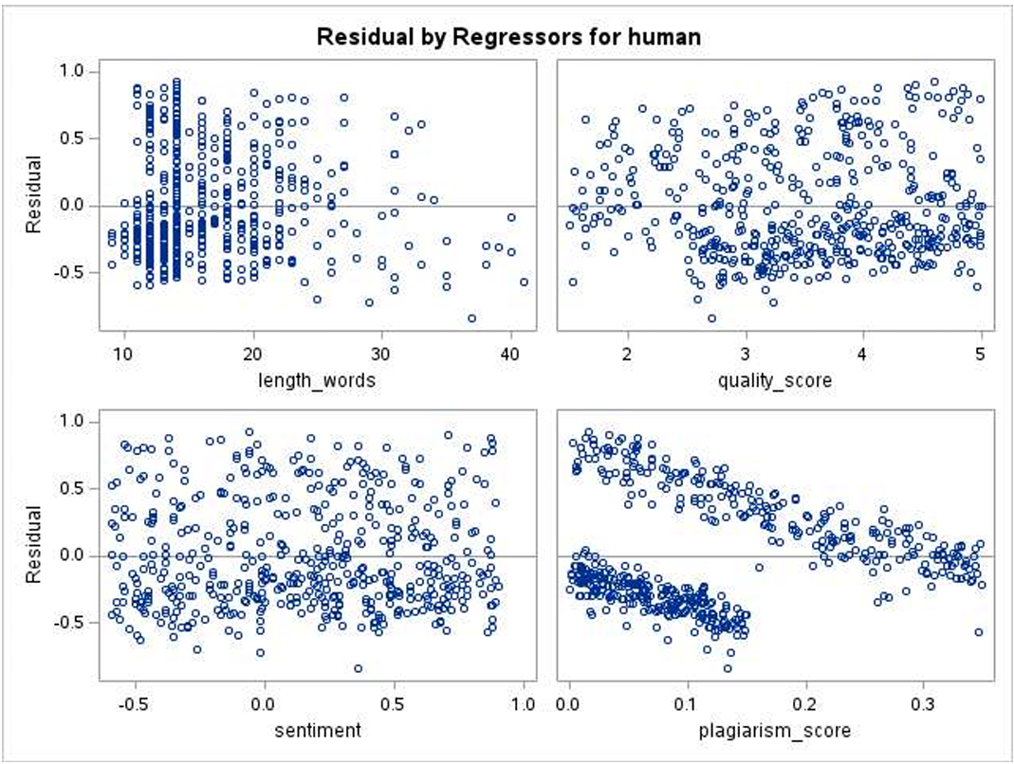
Model Fitting and Analysis
Residual plots and Leverage

Slide 9
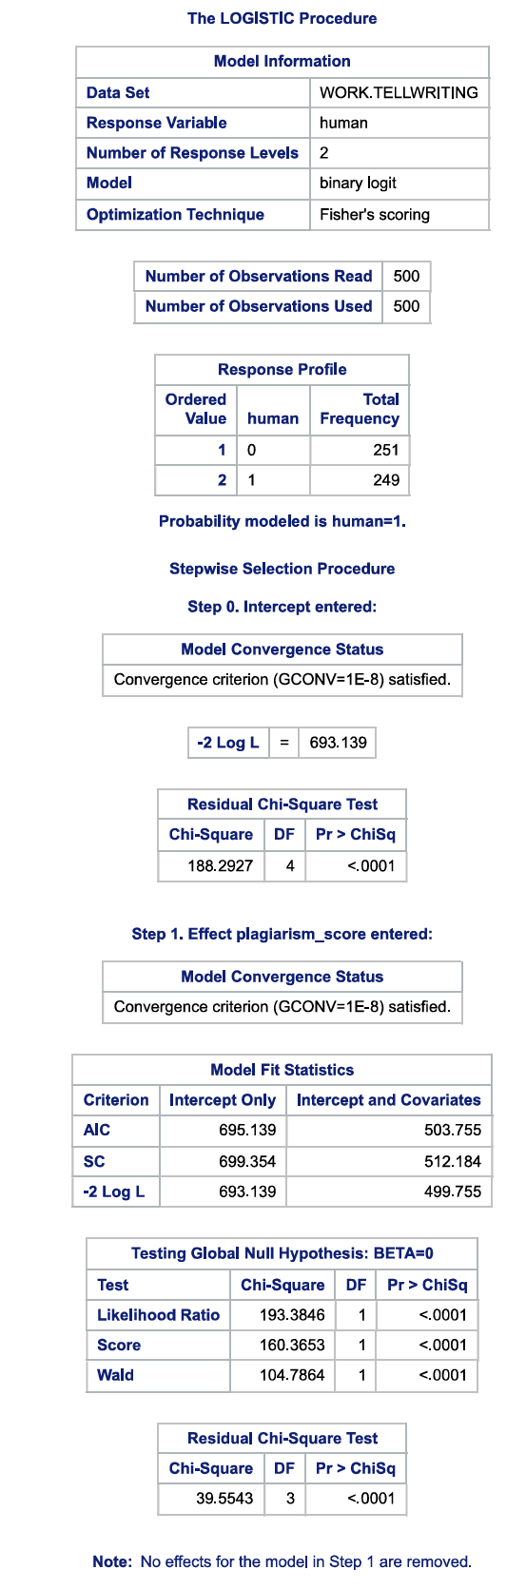
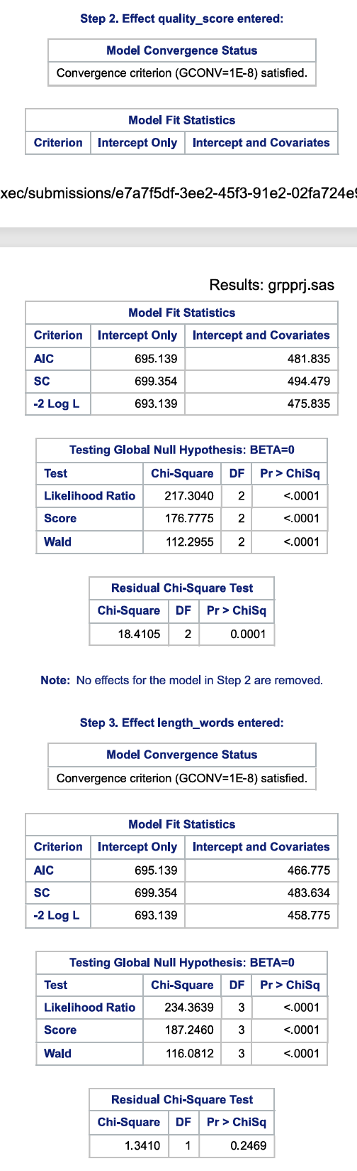
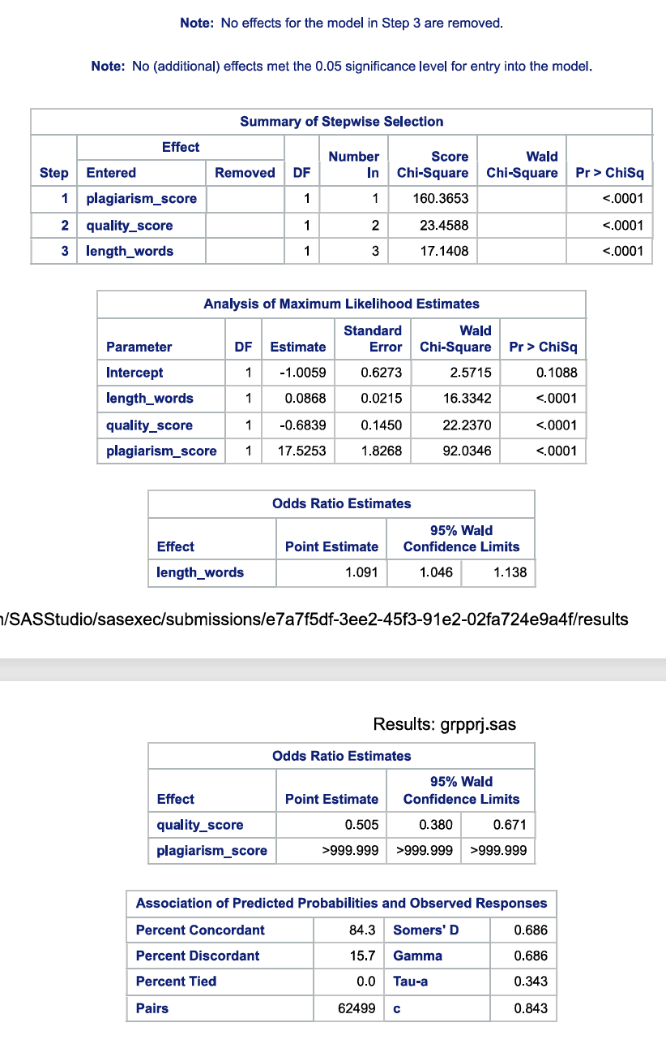
Model Fitting and Analysis
Predictor selection – Stepwise method

Slide 10
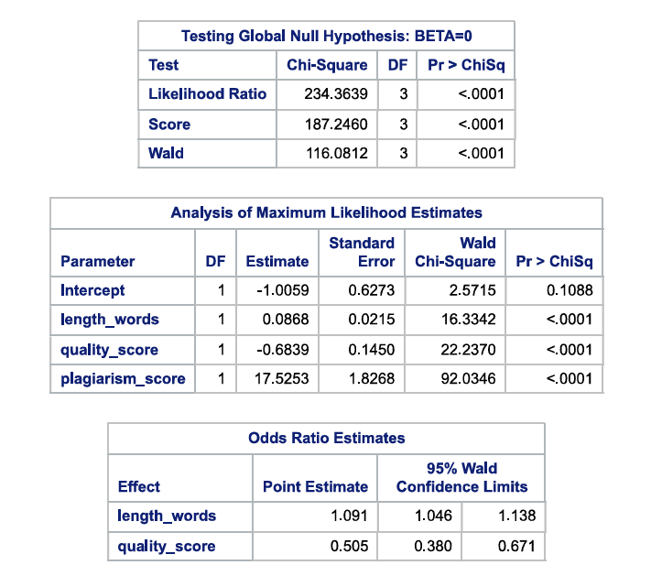
Model Fitting and Analysis
Best Model
Through the stepwise selection method, we found that the best model includes 3 predictors.
Length words: 0.0868
Quality score: -0.6839
Plagiarism Score: 17.5253
And an intercept: –1.0059
Additionally, the likelihood ratio test shows that our model is more significant than the model with 0 predictors.

Slide 11
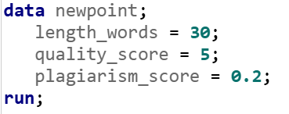
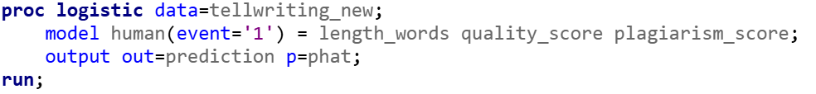
Model Fitting and Analysis
Probability Prediction
We created a dummy observation with some selected values in the 3 predictors of our best model. We set this small data set on top of the old one, and then ran a logistic regression, but output the phat values into a separate data set.
We went to that data set to find this observations likelihood, and we see that they have an 84.352% chance of being a human

Slide 12
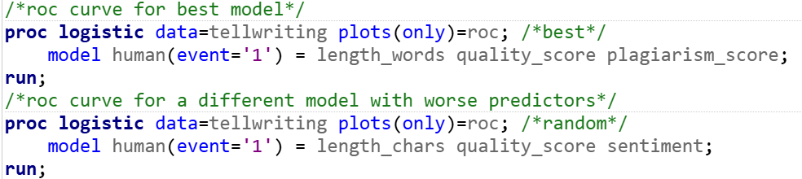
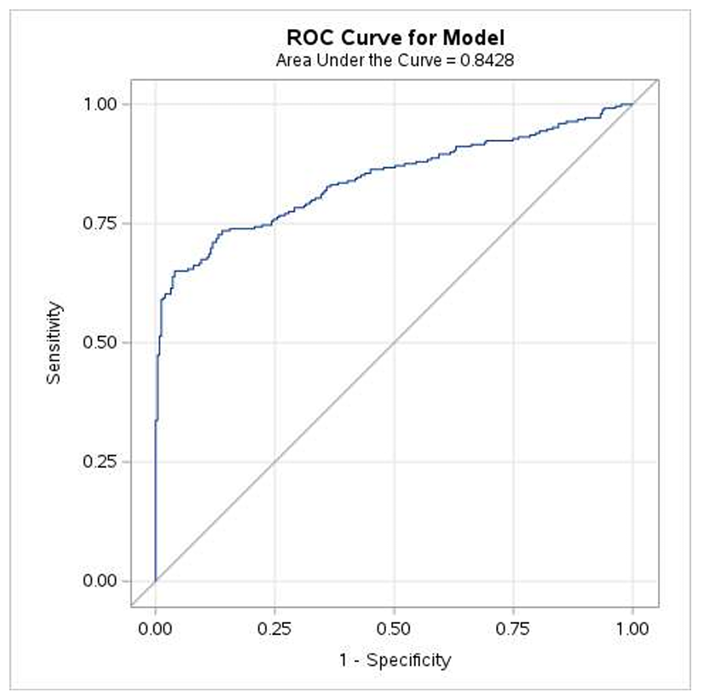
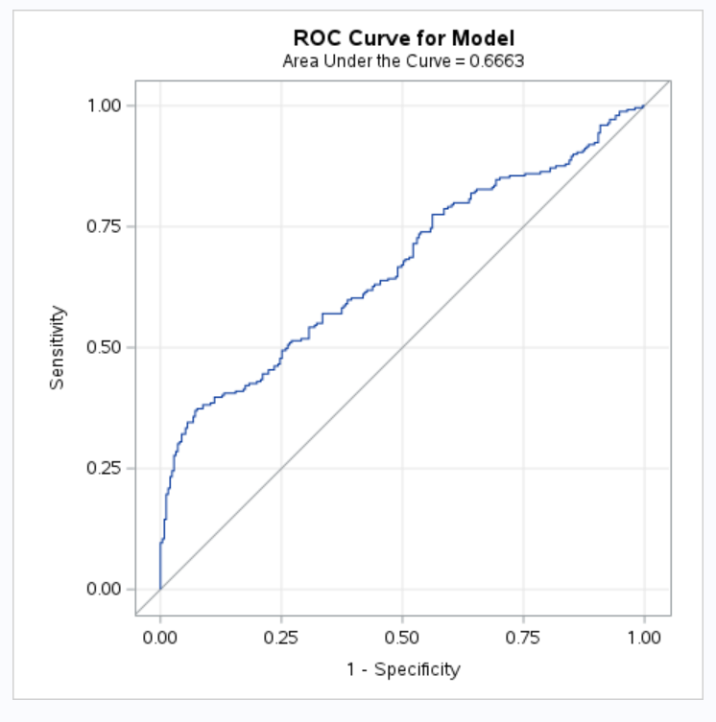
Model Fitting and Analysis
ROC Curve
To get more insight into how effective our model is, we created two ROC curves. The first one included all the predictors in our best model, and the second one included a random set of three.
We can see that the best models ROC curve has an area of 0.8428, while the other only has 0.6663. This difference represents the fact that our model is more effective at predicting whether the writer is human or ai

Slide 13
Conclusion
AI writing is not hard to come by nowadays, so it's useful to have some tools to determine exactly who wrote some text. We found that there are some factors that are useful for predicting if a human wrote some text. The length of words, the quality of the text, and the level of plagiarism are all effective predictors.
It appears that the lengthier excerpts have slightly higher odds of being a human, while high quality strings of text have a slightly higher odds of being an ai. Interestingly, it seems that even having small amounts of plagiarism greatly increases the odds of being a human.
While it is unlikely that we will escape the grasp AI has on modern society, we should ensure that we take the steps to preserve human work and writing. Models like these can help prevent people from trying to pass of AI work as human work.

Slide 14
Certification + Works Cited
https://www.kaggle.com/datasets/prince7489/ai-vs-human-comparison-dataset?resource=download
We certify that this presentation was completed by all members of the group
- Aidan Belmont, Michelle Steinberger, Allison Kreuger, Jill Derodel

